Slide 1

The California
DIVERSION ProgramS
Helping Health Professionals Recover from Substance Use Disorders
OCTOBER 10, 2019

Slide 2
VIRGINIA MATTHEWS, RN, BSN, MBA
Project Manager
MAXIMUS

Slide 3

Topics of Discussion
Signs, Symptoms and Impact of Substance Abuse in the Workplace
What is the Diversion Program?
Notes:
Topics of Discussion
What is Substance Use Disorder (formerly “Addiction”)? - Prevalence of Substance Use Disorder.
Impact of substance use disorder on the healthcare profession
Signs, Symptoms and Impact of Substance Abuse in the Workplace
Prevention and identification of drug diversion
What is the Intervention Program? – Components of the Intervention Program
How the California Intervention Program can help nurses recover from SUDs and return to safe practice

Slide 4








MAXIMUS Serves 8 Health Professional Licensing Boards
Board of Registered Nursing
Board of Pharmacy
Physical Therapy Board of California
Osteopathic Medical Board
Veterinary Medical Board
Physician Assistant Committee
Dental Board of California
Dental Hygiene Committee

Slide 5
Risk For healthcare professionals
Case study:
Relapse Events
State: California
Rate of relapse: In a retrospective study of relapse events, MAXIMUS identified that 75% of relapses occurred during first year of participation in the program, and 80% of those were during the first six months.
10-14%
General population diagnosed with SUD
10-15%
Healthcare Professionals diagnosed with SUD*
>85%
General population relapse within first year of recovery**
13%
MAXIMUS Diversion Program participants relapse during first four years of recovery
*Prevalence of substance abuse by physicians is between 10% and 15%. [Elliot 2010; O’Connor 1997; McCall 2001; Oreskovitch 2012; Berge 2009; Brooks 2012; Baldisseri 2007]
**Annu Rev Clin Psychol. 2007; 3():257-84.

Slide 6
Article 3.5. Diversion Evaluation Committees
§ 4860. Legislative intent
  It is the intent of the Legislature that the Veterinary Medical Board seek ways and means to identify and rehabilitate veterinarians and registered veterinary technicians with impairment due to abuse of dangerous drugs or alcohol, affecting competency so that veterinarians and registered veterinary technicians so afflicted may be treated and returned to the practice of veterinary medicine in a manner that will not endanger the public health and safety.

Slide 7
Goal of the Diversion Program
Protect the public health and welfare from Healthcare Professionals who may be impaired as the result of substance use disorders
Immediately intervene and provide rehabilitation, help and hope in order to return the individual to safe practice.

Slide 8
Who is the Diversion Program?
Participant
Board
MAXIMUS
Support Group Facilitator
Diversion Evaluation Committee
Random Drug Testing
Worksite Monitor
Notes:
Before we get into the components of the program, a brief overview of the folks involved with the Program.
BRN
Program staff
Responsible for identifying RNs in complaints who may benefit from the program and reaching out to those RNs
Managing program policies and scope of work of the program contract
Maximus
Contractor who administers the Program - Maintaining a toll-free telephone system 24 hours a day, seven days a week.
Completing comprehensive assessments of applicants
Monitoring and supporting applicants and participants
Case Management through the process of Recovery
Project Manager, Clinical Case Managers, Compliance Monitors, lab vendor, Clinical Assessors, therapists, etc.
Evaluation Committees
which is made up of individuals appointed by the boards
Each with a background in substance misuse or abuse disorders and/or mental illness treatment
Average 150-200 years of experience with SUDs at the meeting
EXTRA NOTE: 5 of the 8 Boards use this model

Slide 9
Application Process
Board Referral - Participant agrees to participate in Diversion program after being notified by the Board that there is a complaint and investigation.
Self Referral - Participant contacts MAXIMUS and requests to join the program
Program is voluntary, must request to join
Participant is enrolled in the Program, the investigation is completed, then set aside as long as the participant remains compliant and successfully completes
In all cases, the Board is aware that the participant is enrolled in the program, and the case is managed in the same way

Slide 10

Initial Program Steps
Intake assessment (phone)
Clinical assessment (in-person with licensed clinician), no charge to applicant
Entry into treatment, as recommended
Weekly communication with MAXIMUS team (Case Manager) until seen by Committee, then monthly
Remove from work until determined safe to practice

Slide 11
Program Components
Community-based Support Groups
  12-Step Meetings or Community Support Groups (AA/NA, Celebrate Recovery, etc.)
  Daily meetings to start (90 in 90)
Peer support group, once weekly
  Led by licensed therapist
Written monthly self report
Weekly check in calls with Case Manager until seen by DEC, then monthly
Notes:
Ongoing communication with Case Manager and Compliance Monitor.
Weekly check in by phone until seen by DEC or reviewed in committee.
Monthly check in by phone for remainder of program.
Written Monthly Self Report
Attend 12-Step Groups (initially daily – 90 meetings in 90 days).
Weekly or twice-weekly Health Professionals Support Group.
Random Drug Testing
Initial review by the IEC.

Slide 12
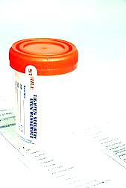
Random Drug Testing
Enroll in Random Drug Testing within 48 hours of intake
Daily check in with lab provider
  (Phone, web or mobile app)
When selected, must test same day
Extensive test panel with low cutoff values (highly sensitive)
Urine most common, also may use hair and blood
ETG/ETS tests for alcohol metabolite in urine (approx. 3 day detection)
PEth tests for alcohol metabolite in blood (approx. 3 week detection)
Hair test for multiple substances (approx. 3 month detection)
Not currently using breath, sweat, saliva or SoberLink

Slide 13

Return to work
Participant must apply to DEC to return to work
DEC evaluates readiness by considering:
  Compliance with program requirements
  Drug test results (Uniform Standards require at least 30 days of negative results to return to work)
  Recommendation of support group facilitator
  Participant’s own report of progress
Notes:
When a participant is ready to return to work, he or she must first apply to return to work
IEC evaluates readiness, considers drug test results, compliance with program requirements, recommendation of support group facilitator

Slide 14
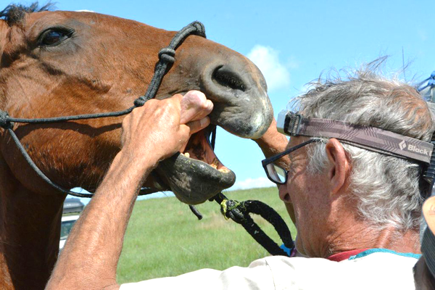
Return to Work
When a job is offered, must identify a worksite monitor
Participant must submit release of information
Agreement signed by worksite monitor (WSM)
Provide contact information for WSM and employer
MAXIMUS Case Manager must provide training to WSM

Slide 15
Return to Work
Submit Org Chart to demonstrate that the Worksite Monitor is at least one step above the participant on the Org Chart
In private practice, monitor must be a peer willing to make unannounced visits
Submit Job Description
Submit Affidavit that WSM meets criteria, has been trained, and agrees to expectations of position
Notes:
Can we go more into the worksite monitor’s responsibilities?

Slide 16
Program Costs
Intake Assessment (no charge to participant)
Clinical Assessment (no charge to participant*)
Program administrative fee
  Veterinarians: $2000 one-time fee may be paid in installments
  Dentists, Dental Hygiene, and RDAs: $100/month;
  RNs: $25/month;
  Pharmacists: $100/mo;
  PAs, PTs & Osteopathic Physicians: $369/month-full administrative fee)
Participant is charged only if they do not attend assessment and fail to give 24-hour notice

Slide 17
Program Costs
Support group (Varies, approx. $20-40 per month)
  Health care costs (varies)
  (e.g., Inpatient, Residential, Intensive Outpatient SUD treatment, psychiatric exam, medications, counseling, therapy, etc
Random Drug Testing (per test, $62.50 + collection fee)

Slide 18
Transition Period--One Year BEFORE COMPLETION
AFTER 2 years of good compliance
Participant is placed on reduced monitoring for a period of one year before granting successful completion
The objective of Transition is to allow the participant to take full responsibility for their own recovery process while still in the Program.
Participant must “petition for Transition” wherein they write an essay examining their life’s journey into recovery, develop a relapse prevention plan, and obtain letters of reference from sponsor, family members and support group facilitator.
Notes:
Participant is placed on minimum monitoring for a period of time before granting successful completion
The objective of Transition is to allow the participant to take full responsibility for their own recovery process while still in the Intervention Program.

Slide 19

Successful Completion Criteria
Demonstrate a manner of living that supports ongoing recovery
Have proof of negative random drug tests, and negative hair and alcohol tests prior to program completion
Have no other evidence of relapse within 24 months of completion date
Have completed at least 3 years of satisfactory participation
Notes:
The following criteria may be considered by an Intervention Evaluation Committee in determining when a registered nurse is ready to successfully complete the Intervention Program.
1. The participant must demonstrate a manner of living that supports ongoing recovery. A written plan that demonstrates that such a manner of living has been developed will be submitted by the participant. This plan will address the emotional, psychological, interpersonal, vocational, economic, spiritual and familial aspects of the participant's life and will demonstrate stability in these areas.
2. A participant must have proof of appropriate body fluid analyses for a minimum of 24 months after acceptance into the Intervention Program. Appropriate body fluid analyses are defined as test results negative for unauthorized drugs or alcohol for chemical dependency cases and maintained therapeutic levels of medication for mental illness cases.
…

Slide 20
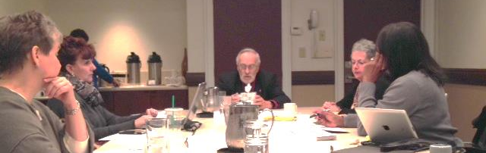
Diversion Evaluation Committee “DEC”
Model is unique to California, and is used by 5 of the 8 Boards
Formally reviews and accepts applicants into the Program
Formulates a participant’s ongoing recovery plan
Reviews and approves requests to change recovery plan
Three meetings annually
Follows Badgely-Keene Open Meeting Act
Notes:
Composition
3 registered nurses
1 physician
1 public member
Experience
Each with a background in substance misuse or abuse and/or mental illness treatment
Average 150-200 years of experience with SUDs at the meeting
Responsibilities
Formally reviews and accepts applicants into the Intervention Program
Formulates the RN’s individualized recovery plan
Other Information
There are 14 IECs across the state
IECs meet quarterly
IECs carry an average 35-40 cases
IECs see about 15 -30 participants per meeting

Slide 21
§ 4870. Agreements of participants to cooperate with treatment program
Each veterinarian and registered veterinary technician who requests participation in a diversion program shall agree to cooperate with the treatment program designed by a diversion evaluation committee. Any failure to comply with the provisions of a treatment program may result in termination of the veterinarian's or registered veterinary technician's participation in a program.

Slide 22
DEC Members
Appointed by the Board, majority vote
Three members of a diversion evaluation committee shall constitute a quorum for the transaction of business at any meeting. Any action requires the majority vote of the diversion evaluation committee.
Each diversion evaluation committee shall have the following composition:
  (a) Three veterinarians licensed under this chapter. The board in making its appointments shall give consideration to recommendations of veterinary associations and local veterinary societies and shall consider, among others, where appropriate, the appointment of veterinarians who have recovered from impairment or who have knowledge and expertise in the management of impairment.
  (b) Two public members.
Each person appointed to a diversion evaluation committee shall have experience or knowledge in the evaluation or management of persons who are impaired due to alcohol or drug abuse.

Slide 23
DUTIES OF DEC COMMITTEE
Each diversion evaluation committee shall have the following duties and responsibilities:
(a) To evaluate those veterinarians and registered veterinary technicians who request participation in the program according to the guidelines prescribed by the board and to consider the recommendation of the administrative physician on the admission of the veterinarian or registered veterinary technician to the diversion program.
(b) To review and designate those treatment facilities to which veterinarians and registered veterinary technicians in a diversion program may be referred.
(c) To receive and review information concerning veterinarians and registered veterinary technicians participating in the program.

Slide 24
DUTIES OF DEC COMMITTEE
(d) To call meetings as necessary to consider the requests of veterinarians and registered veterinary technicians to participate in a diversion program, and to consider reports regarding veterinarians and registered veterinary technicians participating in a program from an administrative physician, or from others.
(e) To consider in the case of each veterinarian and registered veterinary technician participating in a program whether he or she may with safety continue or resume the practice of veterinary medicine or the assisting in the practice of veterinary medicine.
(f) To set forth in writing for each veterinarian and registered veterinary technician participating in a program a treatment program established for each such veterinarian and registered veterinary technician with the requirements for supervision and surveillance.
(g) To hold a general meeting at least twice a year, which shall be open and public, to evaluate the program's progress, to review data as required in reports to the board, to prepare reports to be submitted to the board, and to suggest proposals for changes in the diversion program.

